Slide 1
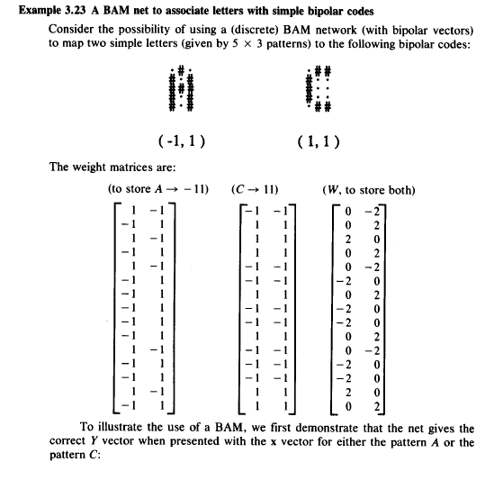

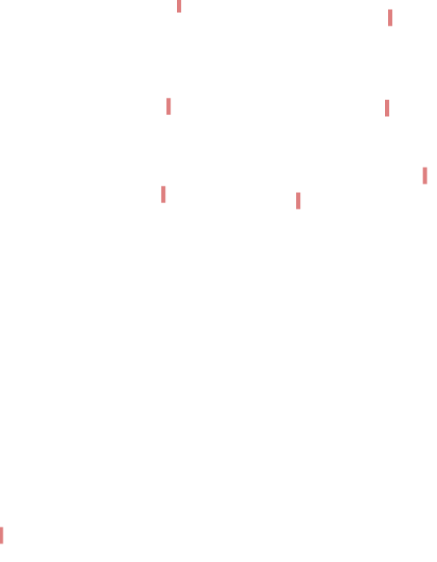
Example

Slide 2
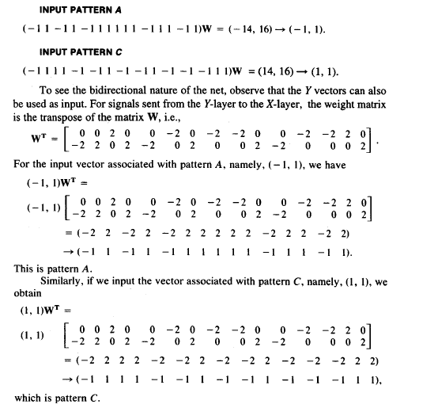
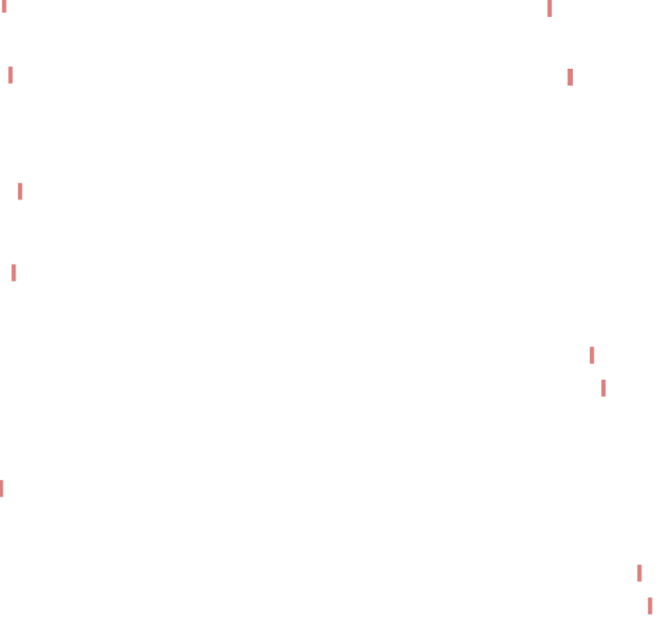
Verification for original patterns (former example)

Slide 3
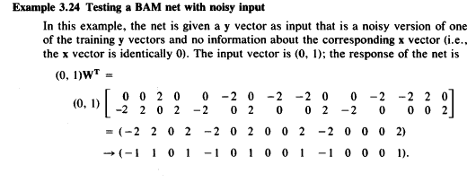
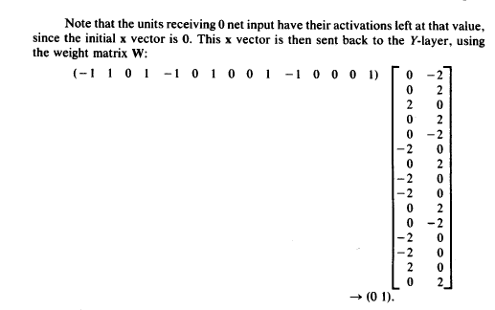
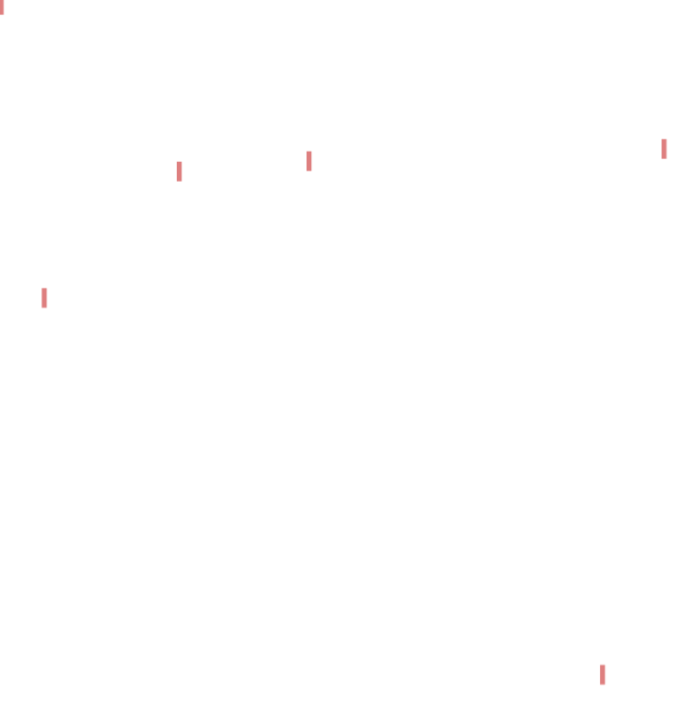
test for noisy patterns (former example)
Converged to non-original patterns

Slide 4
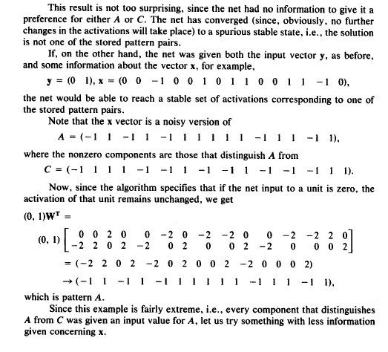
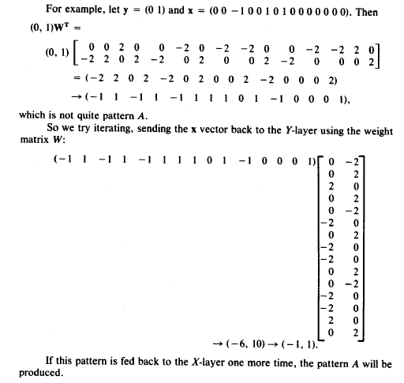
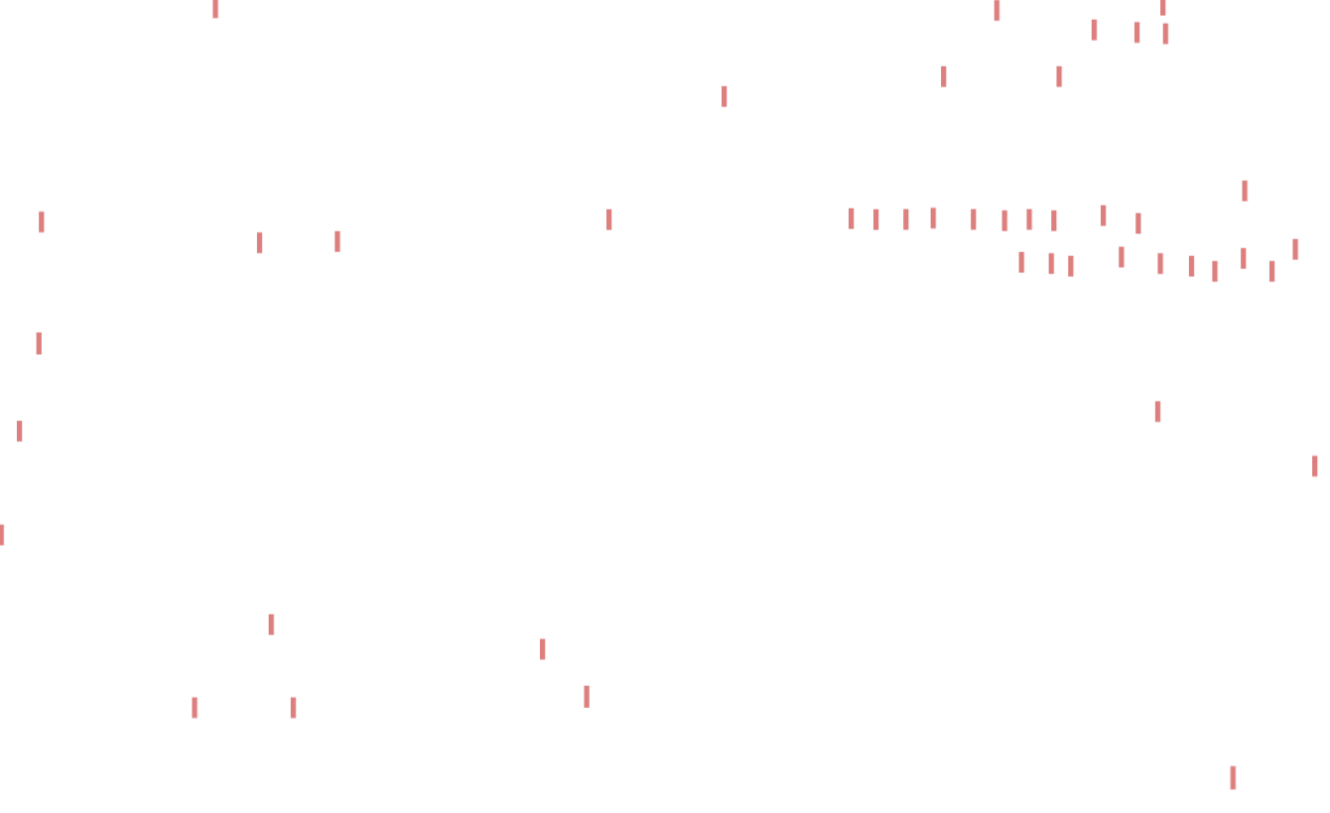
test for noisy patterns with modifications (former example)

Slide 5
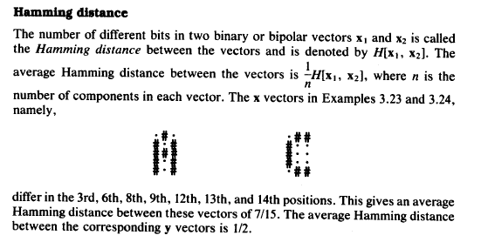
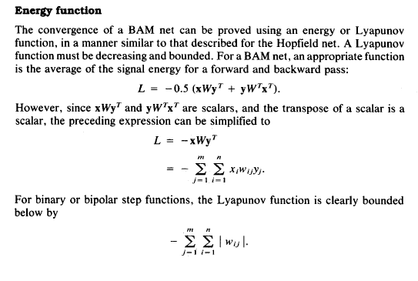
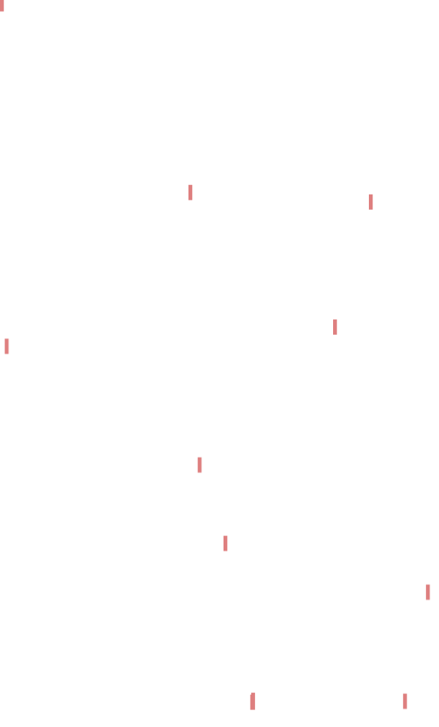
Two notes

Slide 6
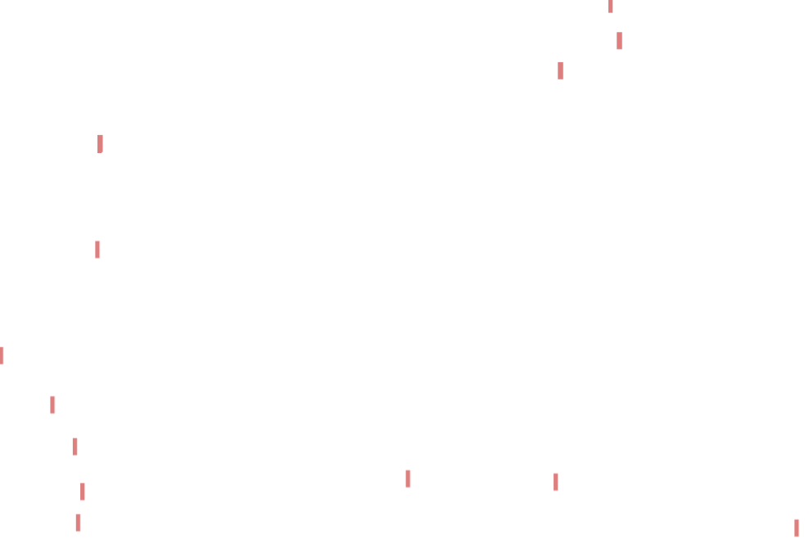
2.1 MNNs with Implicit input patterns
Some known Recurrent NNs
Recurrent Neural Networks(RNNs)
Long-Short Term Memory (LSTM)
Gated Recurrent Unit (GRU)
Such Networks make nonlinear non-homogenous difference Equations. By solving such equations, the nonlinear functions, which generate the output patterns based on the implicit sequenced input patterns, are revealed.
Recurrent structures will make a plenty of memories utilized in pattern associations between implicit inputs and target outputs.
Pattern Association (Memories) types.
One to one: many classification problems and identification by fingerprint/biometric signals/signature/…
Many to one: voice/handwriting/walking in identification
One to Many-: image captioning/video captioning
Many to Many -- Translation machines...text to picture/Video

Slide 7
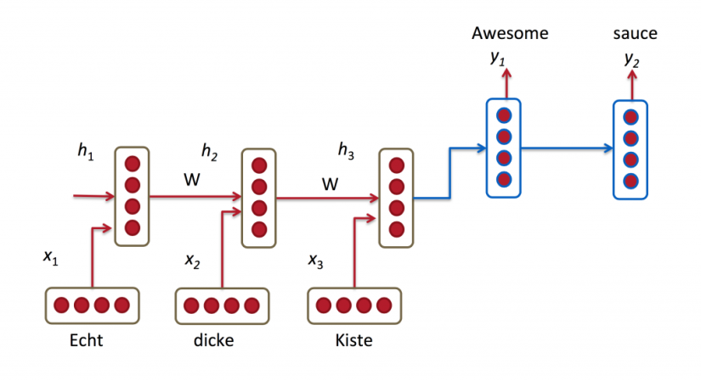
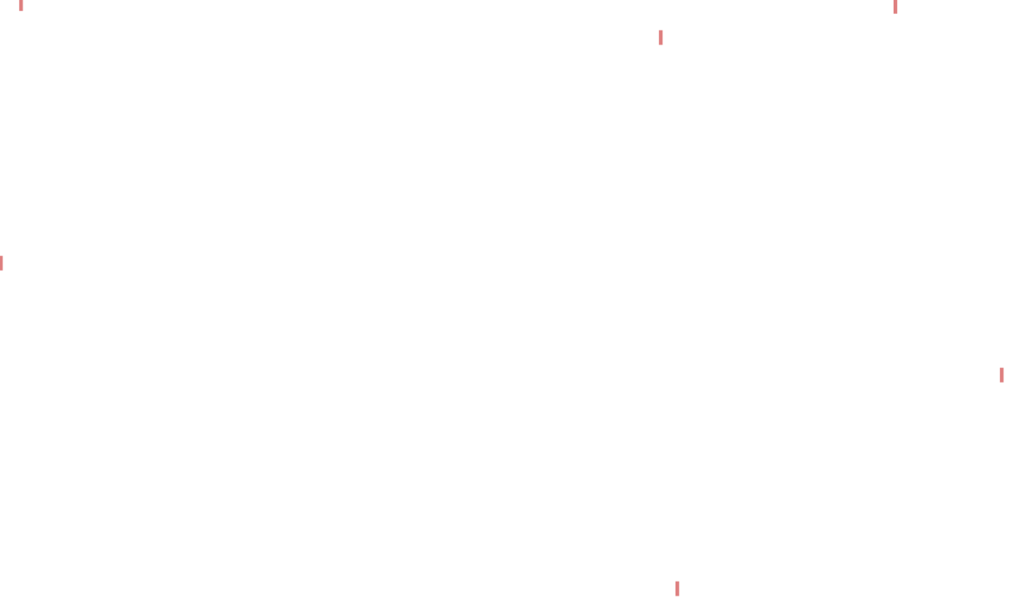
Some Applications of RNNs
Language Modeling and Generating Text
Recurrent neural network based language model
Extensions of Recurrent neural network based language model
Generating Text with Recurrent Neural Networks
Machine Translation
A Recursive Recurrent Neural Network for Statistical Machine Translation
Sequence to Sequence Learning with Neural Networks
Joint Language and Translation Modeling with Recurrent Neural Networks
Given a sequence of words we want to predict the probability of each word given the previous words. Language Models allow us to measure how likely a sentence is, which is an important input for Machine Translation (since high-probability sentences are typically correct).
Machine Translation is similar to language modeling in that our input is a sequence of words in our source language (e.g. German). We want to output a sequence of words in our target language (e.g. English).

Slide 8
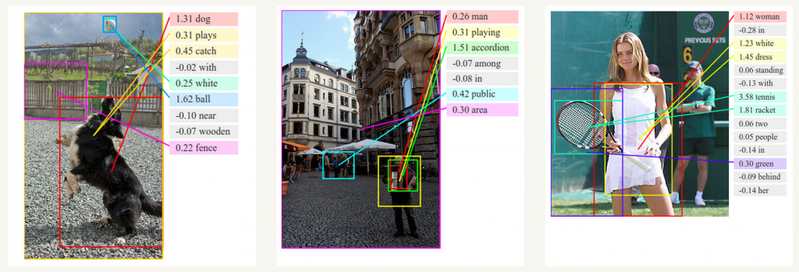
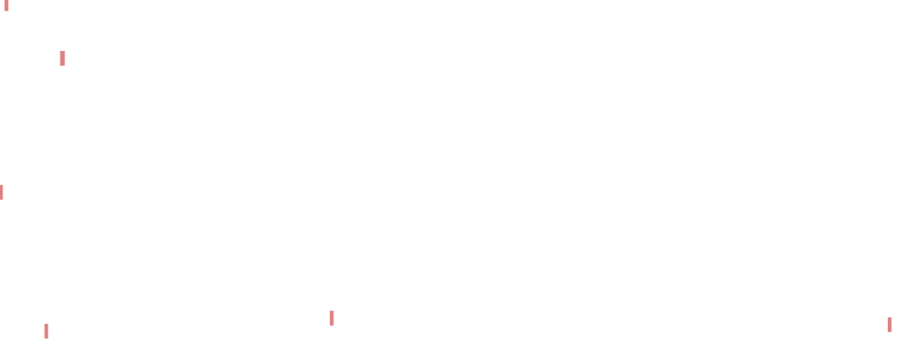
3. Speech Recognition
Given an input sequence of acoustic signals from a sound wave, we can predict a sequence of phonetic segments together with their probabilities.
Towards End-to-End Speech Recognition with Recurrent Neural Networks
4. Generating Image Descriptions
Together with convolutional Neural Networks, RNNs have been used as part of a model to generate descriptions for unlabeled images

